Slide 1
JDBC GUI Application
Prepared By
Jayprakash S.Nair
Binu Thomas Abraham
Albin Johnson

Slide 2
Introduction
Java in its core is inherently a GUI language,rich in more than one graphical user interface,such as AWT,Swing,JavaFX,SWT and so forth.It presents a user friendly mechanism for application interaction,giving a distinctive look and feel.Although they different architectural cores,they do not fail to provide applications with consistent ,intuitive user interface components.JDBC programming is really hard to realize without a GUI interface.These frameworks are suitable for creating database-oriented desktop applications.

Slide 3
What is Java GUI?
Java GUI programming involves two packages,the abstract windows kit(AWT) and the newer swing toolkit.Swing components have the prefix J to distinguish them from the original AWT ones (eg:-JFrame instead of Frame).To include swing components and methods in your project,you must import the java.awt* ,java.awt.event* packages.Displayable frames are top-level containers such as JFrame,JWindows,JApplet etc.JPanel and JScrollPane are examples of intermediate containers.Containers are therefore widgets or GUI controls that are used to hold or group other widgets such as text boxes,check boxes,radio buttons etc.Every GUI starts with a window meant to display things.

Slide 4
What is JDBC?
Java Database Connectivity (JDBC) is an application programming interface(API) for the programming language Java, which defines how a client may access a database. It is a Java-based data access technology used for Java database connectivity. It is part of the Java Standard Edition platform, from Oracle Corporation. It provides methods to query and update data in a database, and is oriented toward relational databases. A JDBC-to-ODBC bridge enables connections to any ODBC-accessible data source in the Java virtual machine (JVM) host environment.JDBC ('Java Database Connectivity') allows multiple implementations to exist and be used by the same application. The API provides a mechanism for dynamically loading the correct Java packages and registering them with the JDBC Driver Manager.

Slide 5
CODE
The code is given in a text file as the whole code may not fit in the ppt
Please check the video and text file.
The platform we used for this was NetBeans.

Slide 6
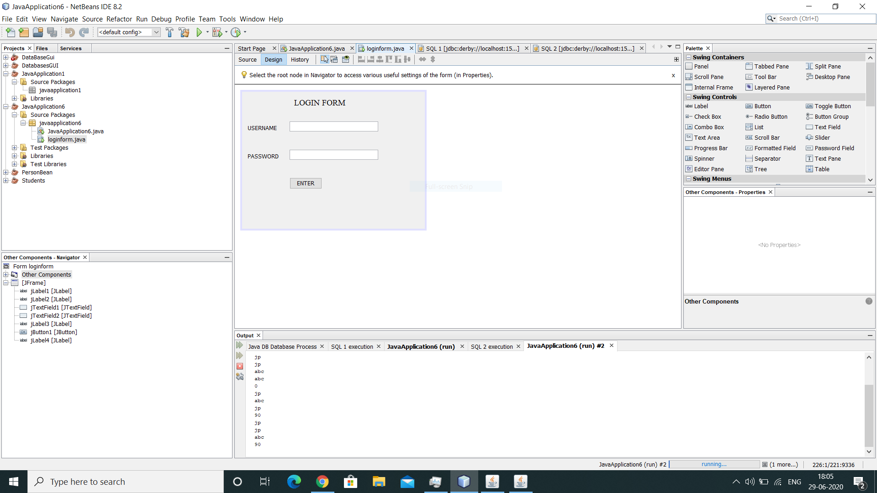
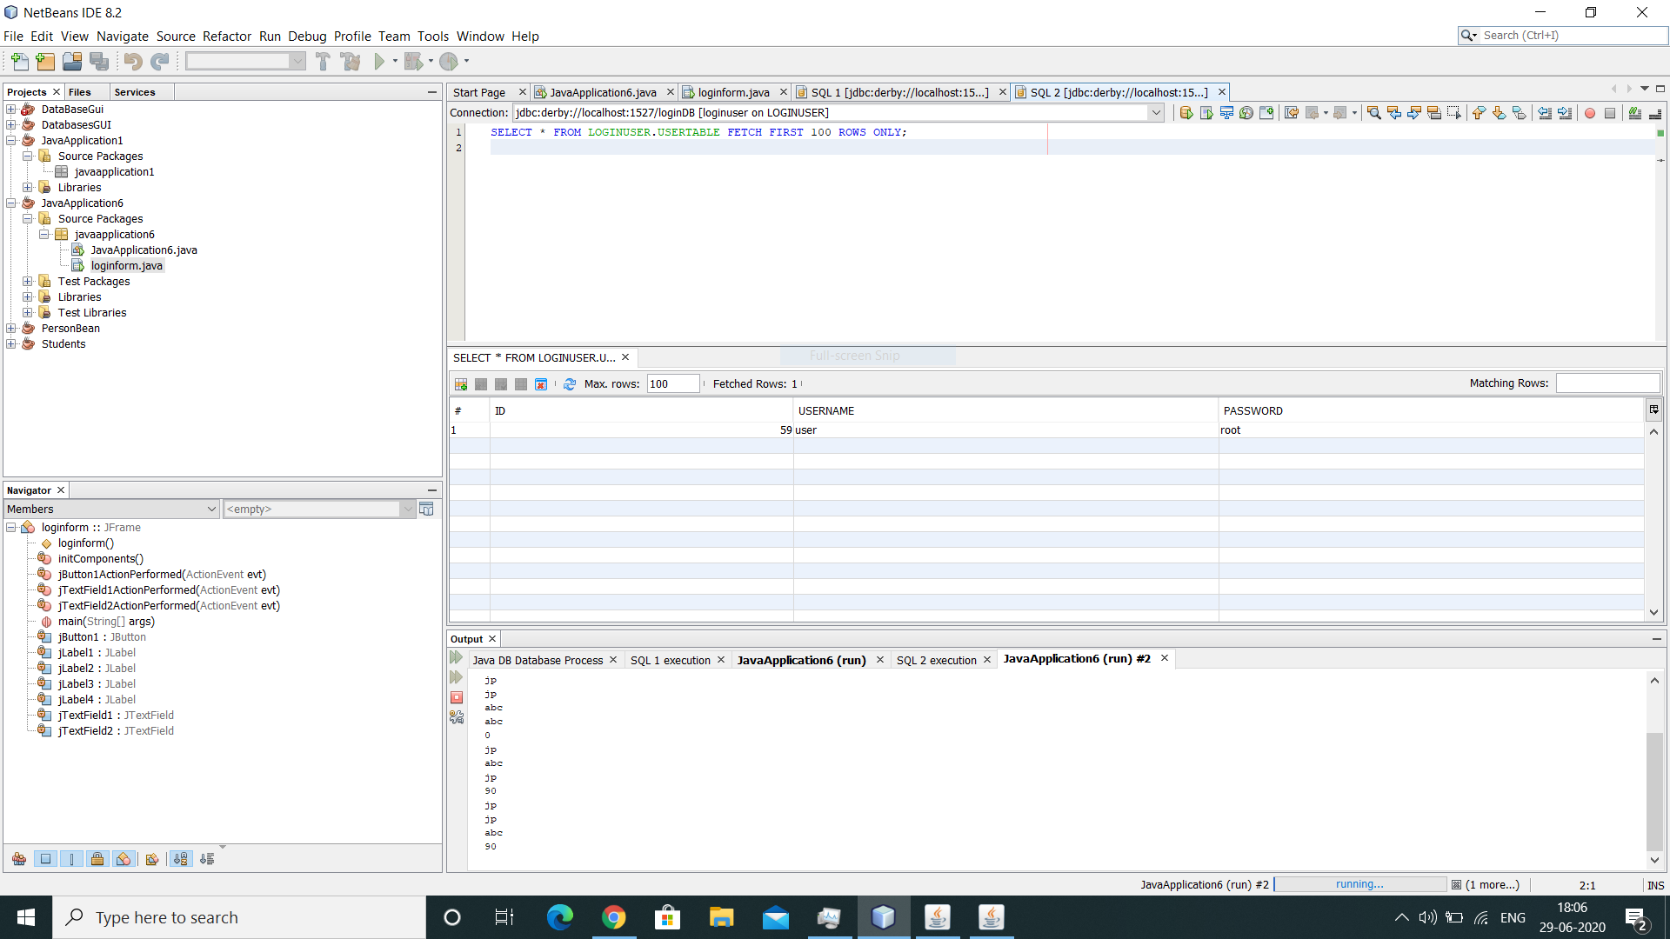
SOME PICS

Slide 7
Thank you

